Slide 1
Machine Learning
Lecture 15c:
Recurrent Neural Networks
& Deep Learning Overview(extra)
Dr. Beilun Wang
Southeast University
School of Computer Science
and Engineering

Slide 2
Today: Deep Learning
Recurrent Neural Networks
Extra:
Neural Architectures with Memory
Learning to Optimize / Learning to Search DNN architecture
Layer-wise pretraining / Auto-Encoder
Learning to Learn
Variants of Input
Tasks in the form of Symbolic input/ outputs / Program Induction
Generative Adversarial Networks (GAN)
Deep Generative Models: Autoregressive Kind
Deep Reinforcement Learning
Robustness / Trustworthiness / Understand / Verify / Test / Evade / Detect Bias / Protect DNN

Slide 3
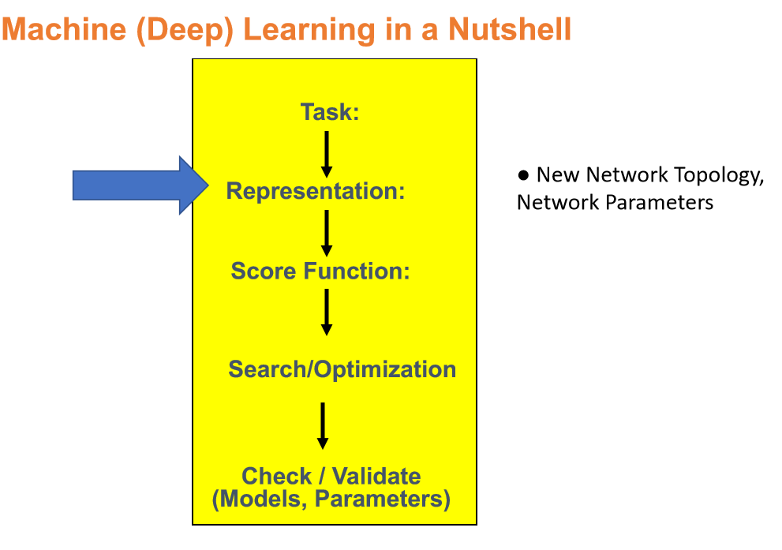

Slide 4
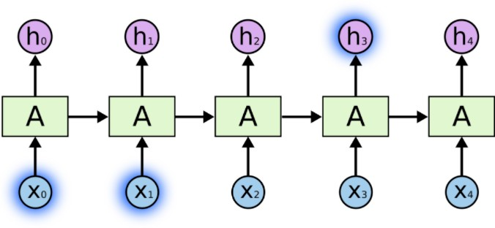
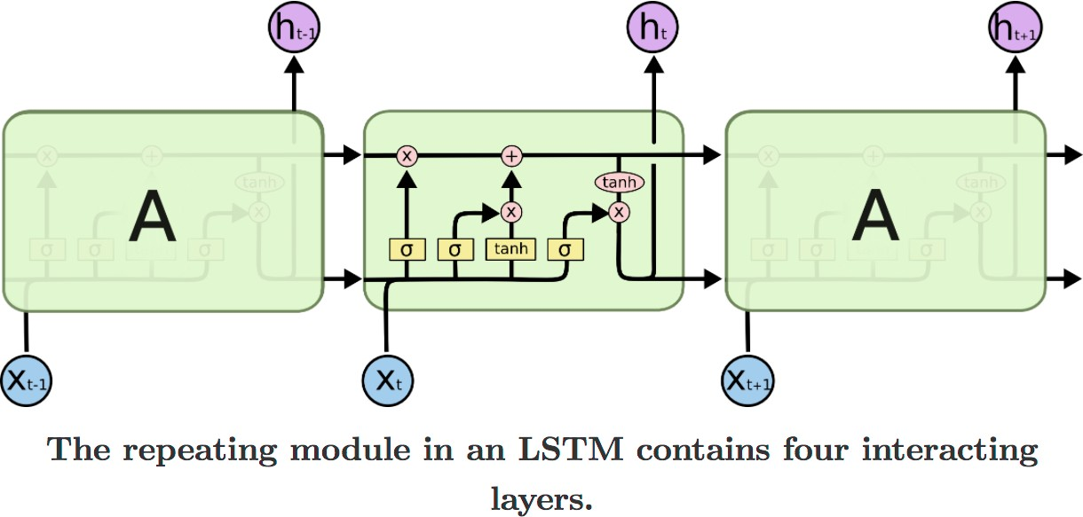
Important Block: Recurrent Neural Networks (RNN)
Prof. Schmidhuber invented "Long short-term memory” – Recurrent NN (LSTM-RNN) model in 1997

Slide 5
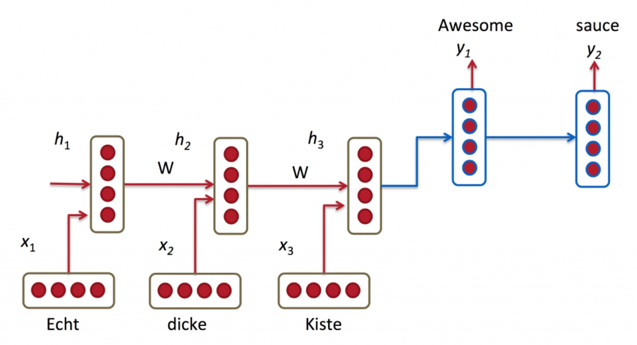
RNN models dynamic temporal dependency
Make fully-connected layer model each unit recurrently
Units form a directed chain graph along a sequence
Each unit uses recent history and current input in modeling
LSTM for Machine Translation
(German to English)

Slide 6
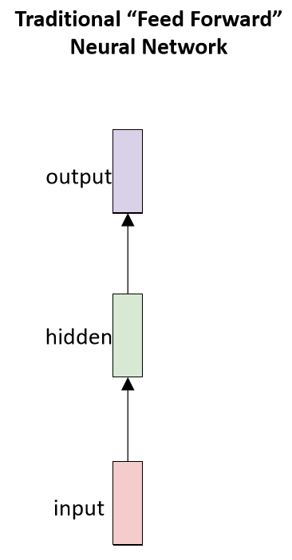
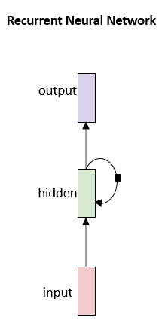
Recurrent Neural Networks (RNNs)
predict a vector at each timestep

Slide 7
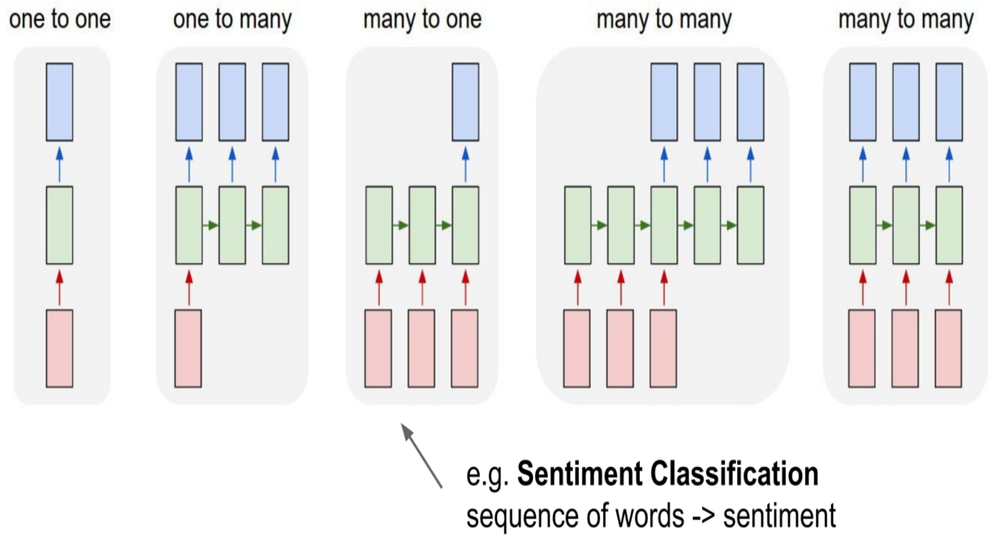
Standard “Feed-Forward” Neural Network

Slide 8
Recurrent Neural Networks (RNNs)
RNNs can handle

Slide 9
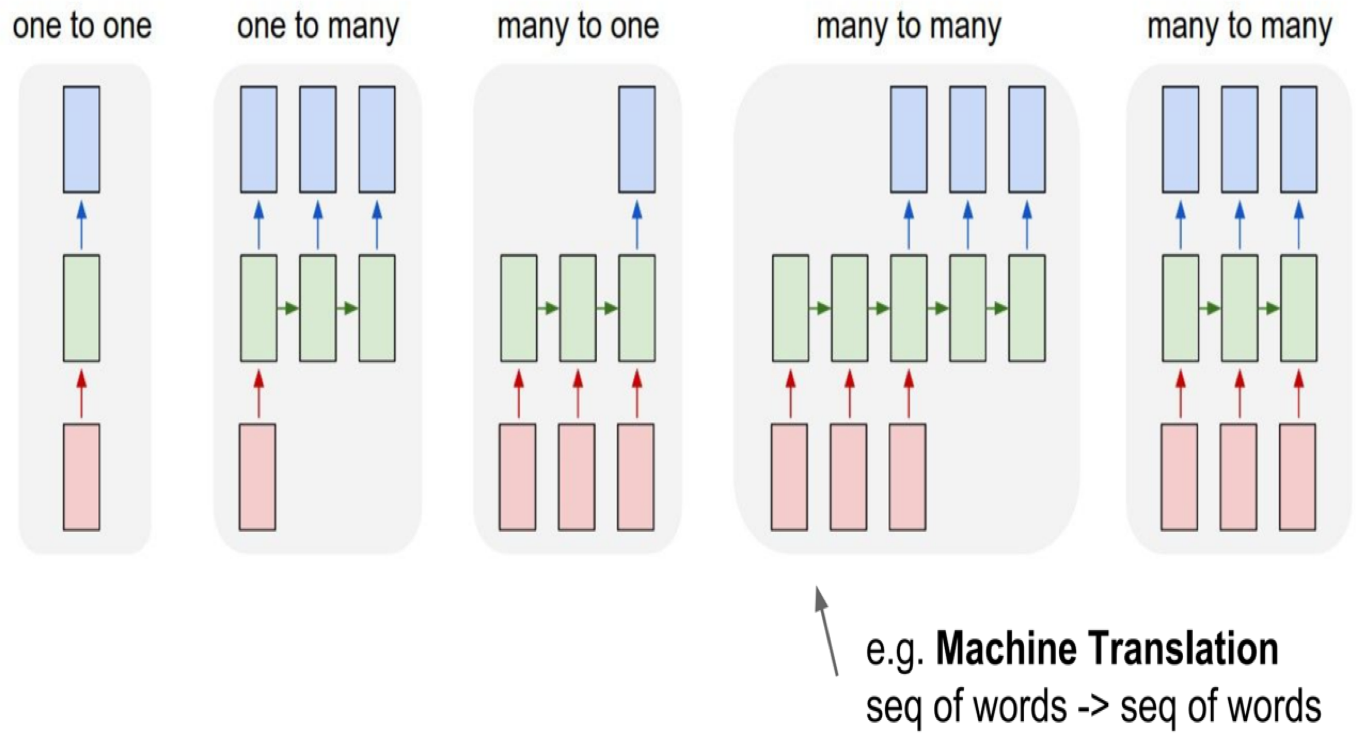
Recurrent Neural Networks (RNNs)
RNNs can handle

Slide 10
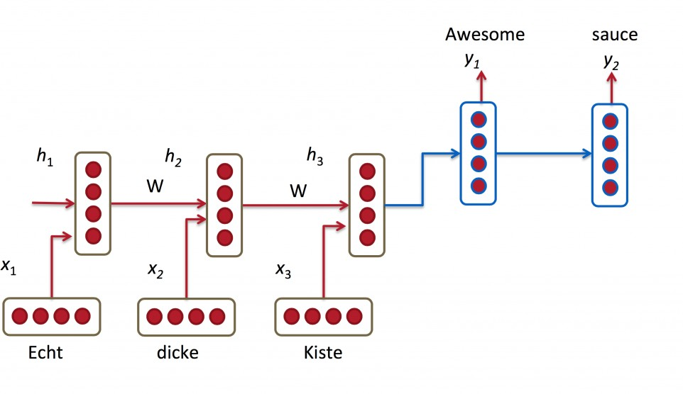
Seq2Seq for Machine Translation
In machine translation, the input is a sequence of words in source language, and the output is a sequence of words in target language.
Encoder: An RNN to encode the input sentence into a hidden state (feature)
Decoder: An RNN with the hidden state of the sentence in source language as the input and output the translated sentence
Encoder-decoder architecture for machine translation

Slide 11
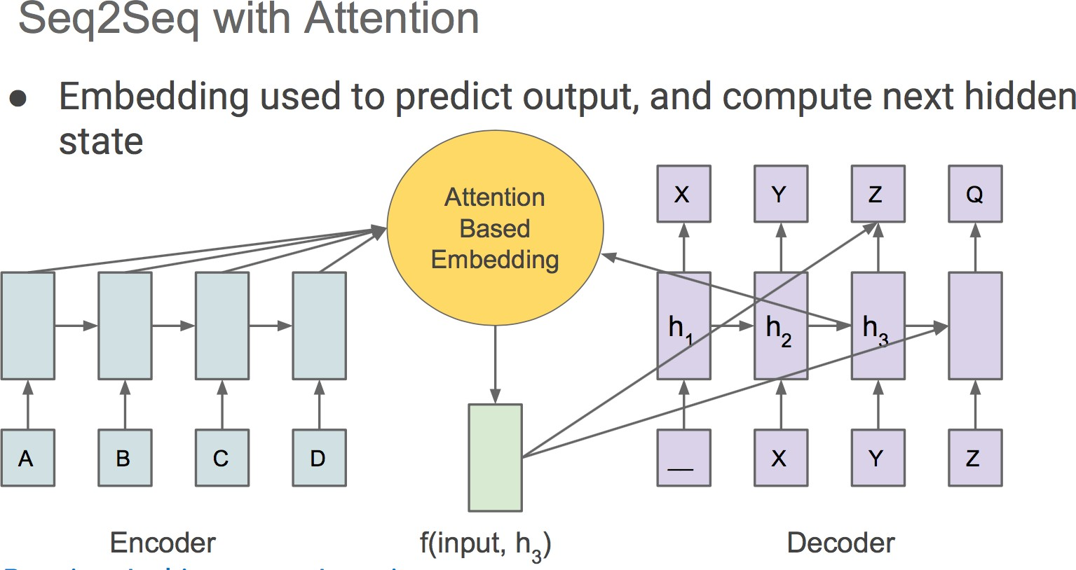
Attention Trick

Slide 12
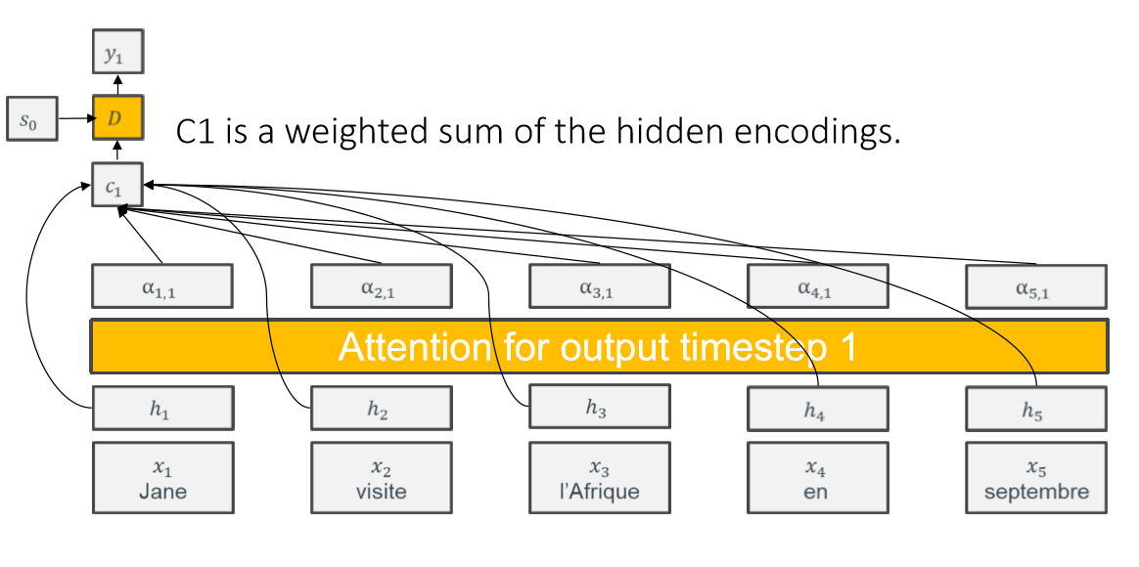
The attention module gives us a weight for each input

Slide 13
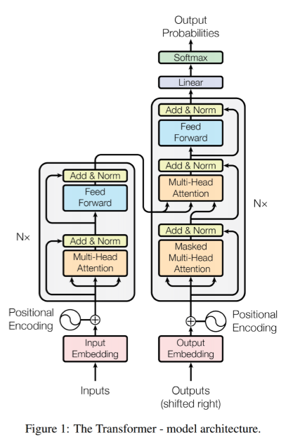
Transformer: Exploiting Self Attentions
A Google Brain model.
Variable-length input
Fixed-length output (but typically extended to a variable-length output)
No recurrence
Surprisingly not patented.
Uses 3 kinds of attention
Encoder self-attention.
Decoder self-attention.
Encoder-decoder multi-head attention.

Slide 14
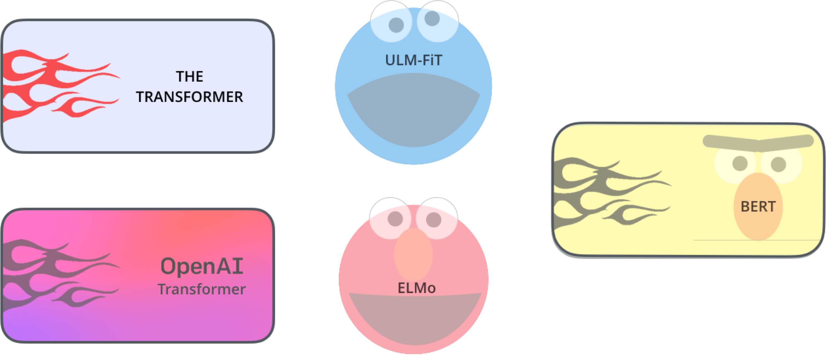
Notable pre-trained NLP models
BERT: Bidirectional Encoder Representations from Transformers
Pre-trained transformer encode for sentence embedding
ELMo: Embeddings from Language Models Pre-trained biLSTM for contextual embedding

Slide 15
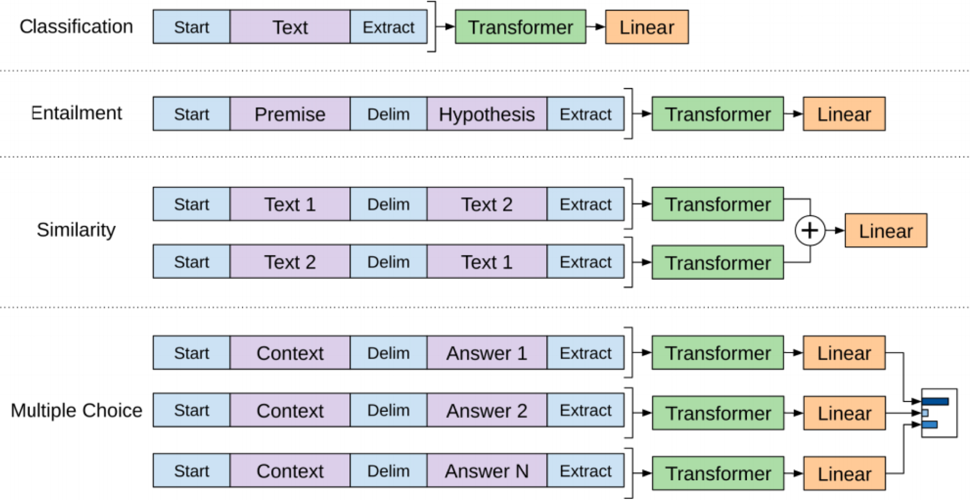
Open AI's GPT-2 is a really large transformer
Different tasks use the OpenAI transformer in different ways.

Slide 16
Today: Deep Learning
Recurrent Neural Networks
Extra:
Neural Architectures with Memory
Learning to Optimize / Learning to Search DNN architecture
Layer-wise pretraining / Auto-Encoder
Learning to Learn
Variants of Input
Tasks in the form of Symbolic input/ outputs / Program Induction
Generative Adversarial Networks (GAN)
Deep Generative Models: Autoregressive Kind
Deep Reinforcement Learning
Robustness / Trustworthiness / Understand / Verify / Test / Evade / Detect Bias / Protect DNN

Slide 17
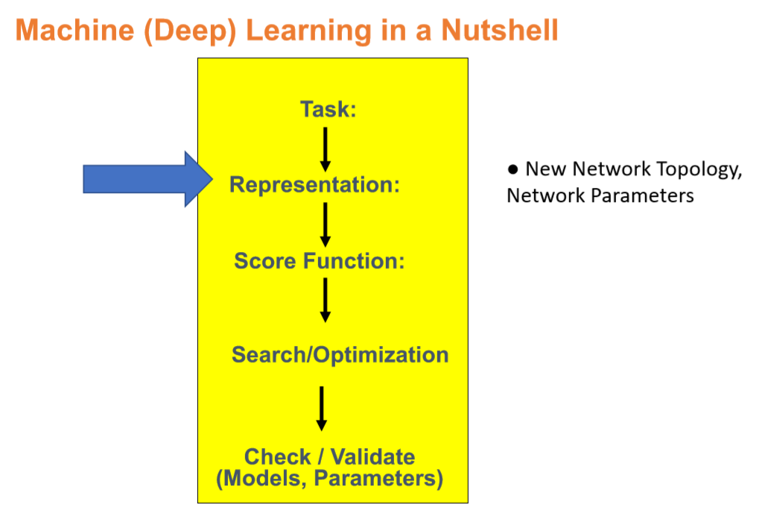

Slide 18
e.g. for Story Comprehension
Joe went to the kitchen. Fred went to the kitchen. Joe picked up the milk. Joe travelled to his office. Joe left the milk. Joe went to the bathroom.
Questions from Joe’s angry mother:
Q1: Where is Joe?
Q2: Where is the milk now?
Q3: Where was Joe before the office?

Slide 19
Need external explicit memory for long-range reasoning
Deeper AI tasks require explicit memory and multi-hop reasoning over it
RNNs have short memory
Cannot increase memory without increasing number of parameters
Need for compartmentalized memory
Read/Write should be asynchronous

Slide 20
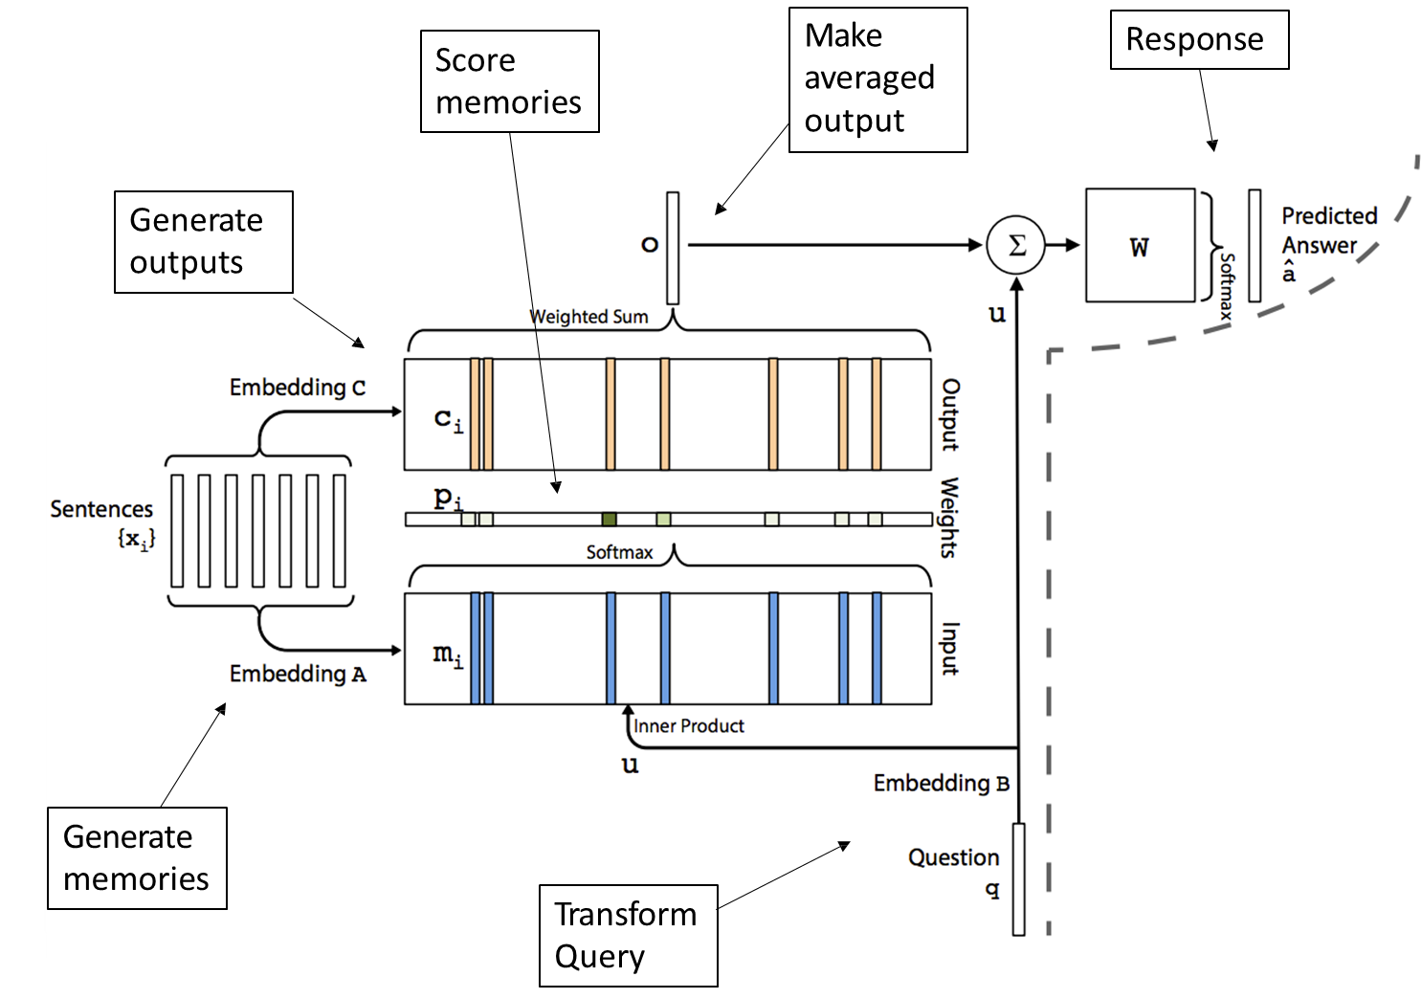
End-To-End Memory Networks

Slide 21
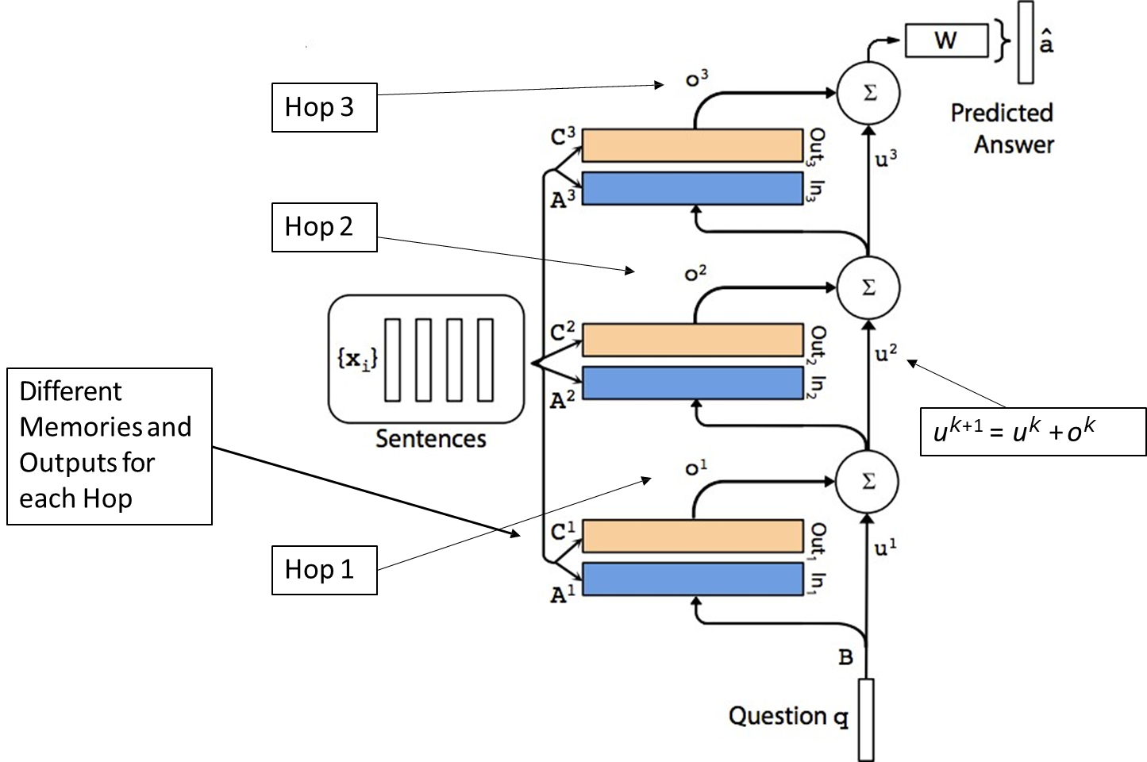
Multi-hop MemN2N

Slide 22
Neural Architectures with Memory
Antoine Bordes, Y-Lan Boureau, Jason Weston, Learning End-to-End Goal-Oriented Dialog, ICLR 2017
Karol Kurach, Marcin Andrychowicz & Ilya Sutskever Neural Random- Access Machines, ICLR, 2016
Emilio Parisotto & Ruslan Salakhutdinov Neural Map: Structured Memory for Deep Reinforcement Learning, ArXiv, 2017
Oriol Vinyals,Meire Fortunato, Navdeep Jaitly Pointer Networks, ArXiv, 2017
Jack W Rae et al., Scaling Memory-Augmented Neural Networks with Sparse Reads and Writes, ArXiv 2016
Junhyuk Oh, Valliappa Chockalingam, Satinder Singh, Honglak Lee, Control of Memory, Active Perception, and Action in Minecraft, ICML 2016
Wojciech Zaremba, Ilya Sutskever, Reinforcement Learning Neural Turing Machines, ArXiv 2016

Slide 23
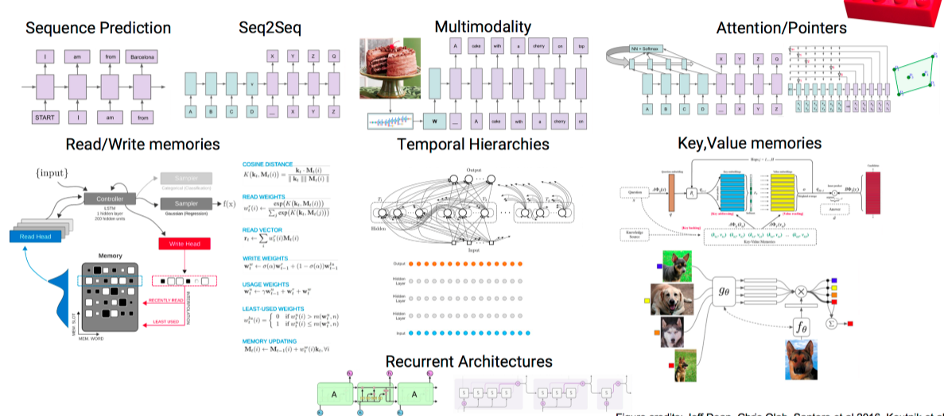
Attention and Memory Toolbox

Slide 24
Today: Deep Learning
Recurrent Neural Networks
Extra:
Neural Architectures with Memory
Learning to Optimize / Learning to Search DNN architecture
Layer-wise pretraining / Auto-Encoder
Learning to Learn
Variants of Input
Tasks in the form of Symbolic input/ outputs / Program Induction
Generative Adversarial Networks (GAN)
Deep Generative Models: Autoregressive Kind
Deep Reinforcement Learning
Robustness / Trustworthiness / Understand / Verify / Test / Evade / Detect Bias / Protect DNN

Slide 25
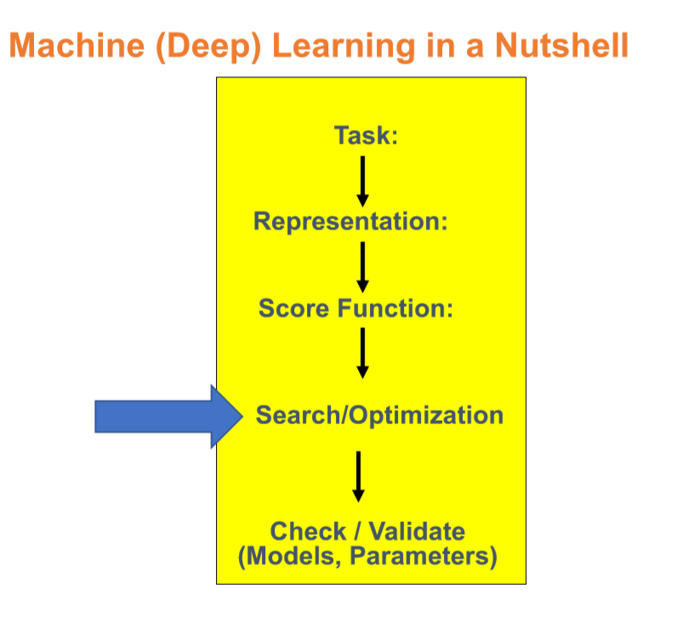

Slide 26
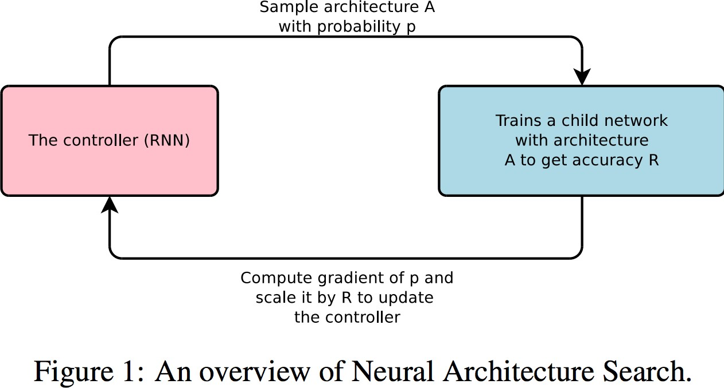
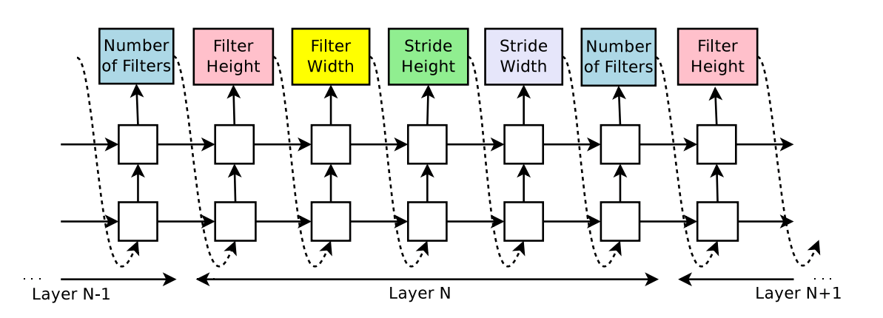
Neural Architecture Search with Reinforcement Learning

Slide 27
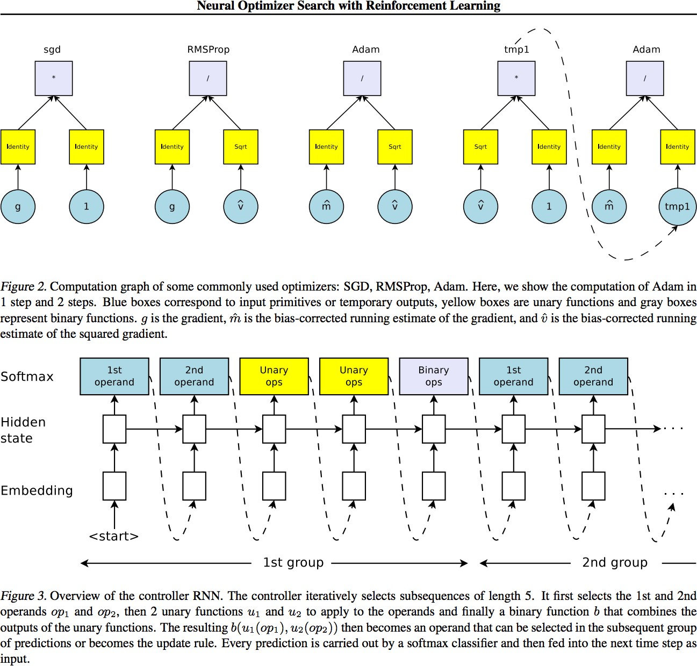
Neural Architecture Search with Reinforcement Learning

Slide 28
Today: Deep Learning
Recurrent Neural Networks
Extra:
Neural Architectures with Memory
Learning to Optimize / Learning to Search DNN architecture
Layer-wise pretraining / Auto-Encoder
Learning to Learn
Variants of Input
Tasks in the form of Symbolic input/ outputs / Program Induction
Generative Adversarial Networks (GAN)
Deep Generative Models: Autoregressive Kind
Deep Reinforcement Learning
Robustness / Trustworthiness / Understand / Verify / Test / Evade / Detect Bias / Protect DNN

Slide 29
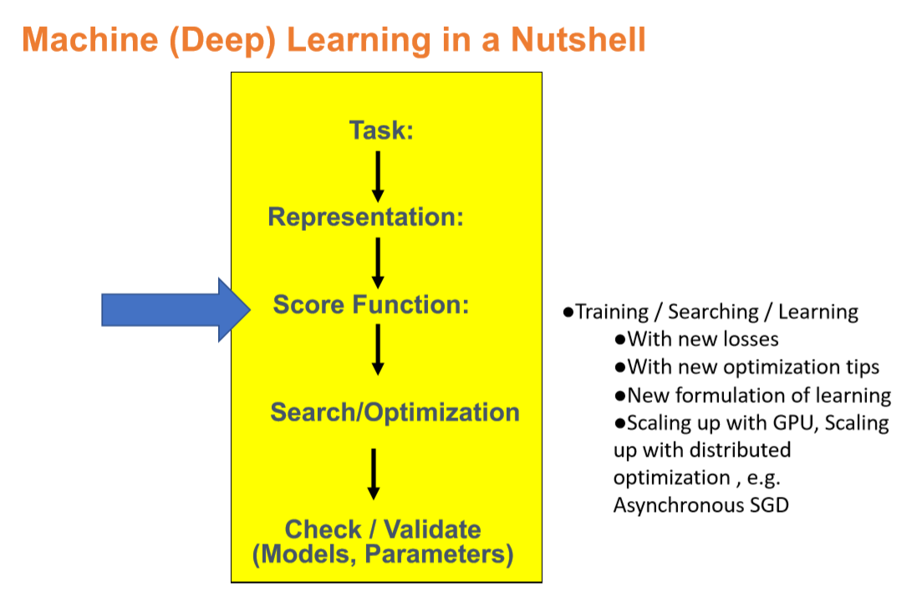

Slide 30
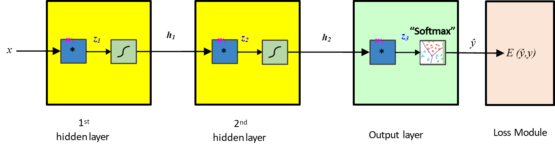
Recap: “Block View”

Slide 31
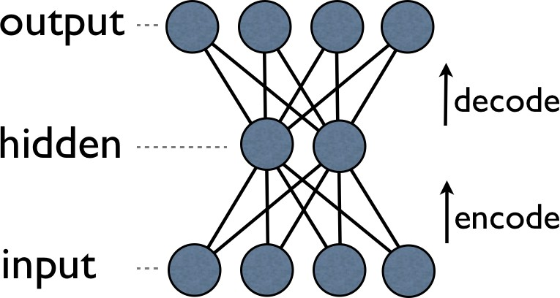
An auto-encoder-decoder is trained to reproduce the input
𝑥'⃗
Minimize diff
|𝑥'⃗- 𝑥⃗|
ℎ
𝑥⃗
Reconstruction Loss: force the ‘hidden layer’ units to become good / reliable feature detectors

Slide 32
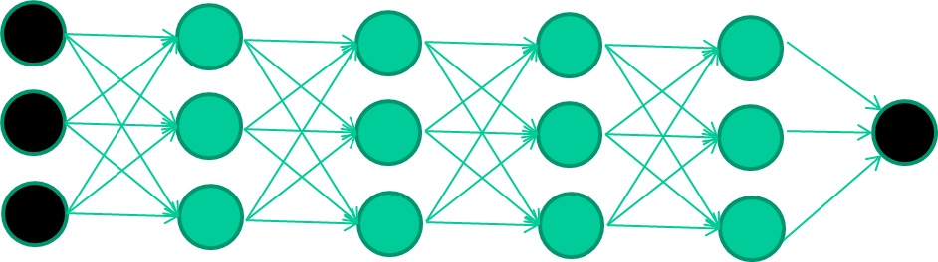
The new way to train multi-layer NNs
Train this layer first

Slide 33
The new way to train multi-layer NNs
Train this layer first
then this layer
then this layer
then this layer
finally this layer
92

Slide 34
The new way to train multi-layer NNs
Each layer can be trained to be an auto-encoder (e.g.,via reconstruction loss)
Basically, it is forced to learn good features that describe what comes from the previous layer

Slide 35
Today: Deep Learning
Recurrent Neural Networks
Extra:
Neural Architectures with Memory
Learning to Optimize / Learning to Search DNN architecture
Layer-wise pretraining / Auto-Encoder
Learning to Learn
Variants of Input
Tasks in the form of Symbolic input/ outputs / Program Induction
Generative Adversarial Networks (GAN)
Deep Generative Models: Autoregressive Kind
Deep Reinforcement Learning
Robustness / Trustworthiness / Understand / Verify / Test / Evade / Detect Bias / Protect DNN

Slide 36
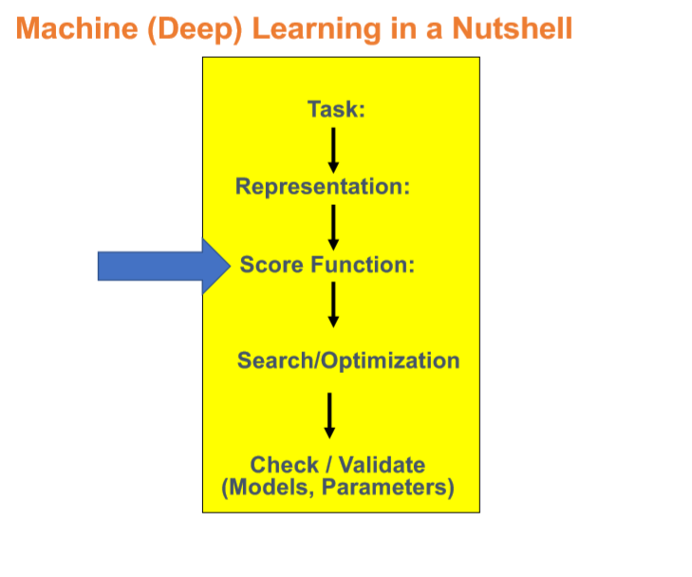

Slide 37
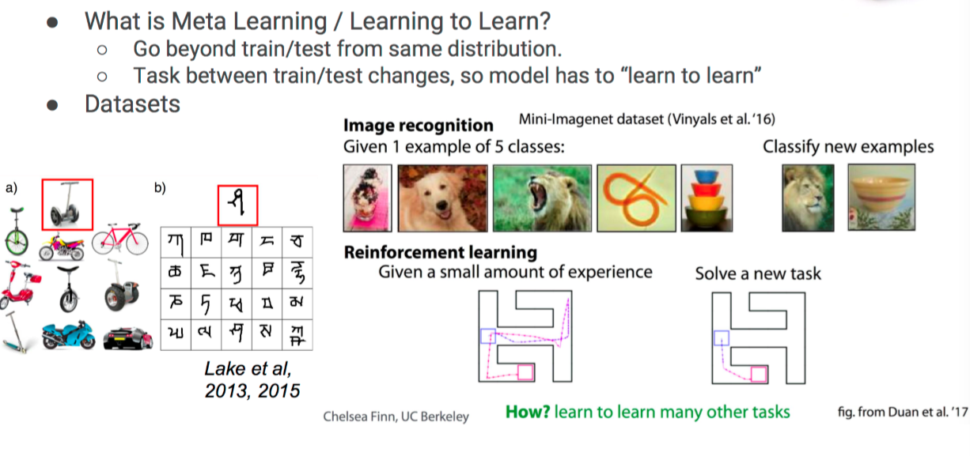
Learning to Learn

Slide 38
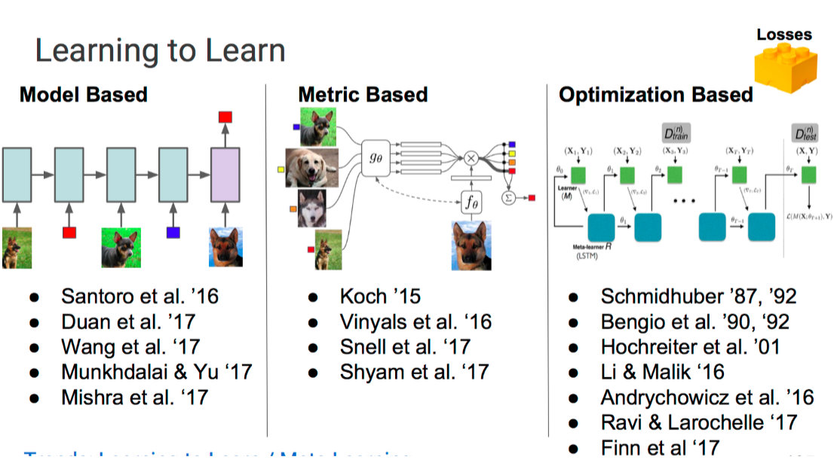
Learning to Learn

Slide 39
Today: Deep Learning
Recurrent Neural Networks
Extra:
Neural Architectures with Memory
Learning to Optimize / Learning to Search DNN architecture
Layer-wise pretraining / Auto-Encoder
Learning to Learn
Variants of Input
Tasks in the form of Symbolic input/ outputs / Program Induction
Generative Adversarial Networks (GAN)
Deep Generative Models: Autoregressive Kind
Deep Reinforcement Learning
Robustness / Trustworthiness / Understand / Verify / Test / Evade / Detect Bias / Protect DNN

Slide 40
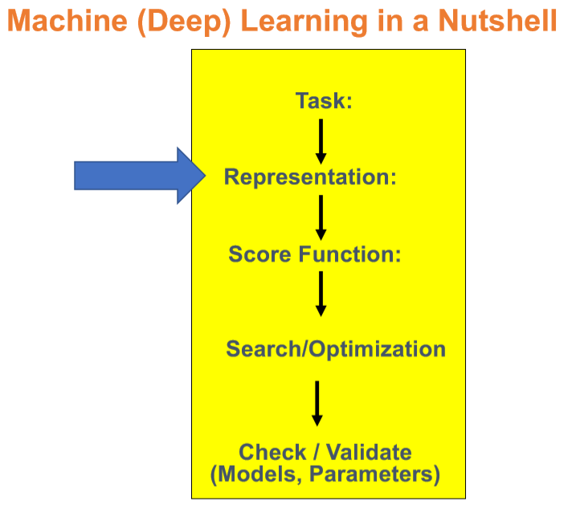

Slide 41
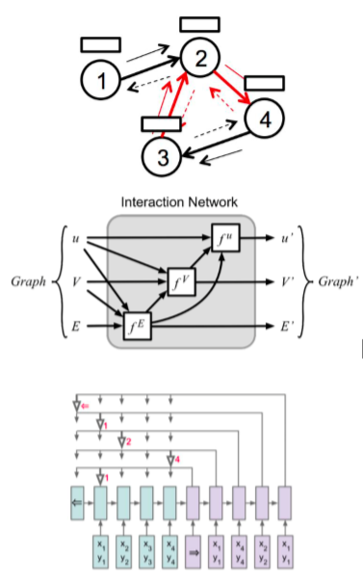
Geometric Deep Learning on Graphs and Manifolds
Graph Nets(GNs) are a class of models that:
Use graphs as inputs and/or outputs and/or latent representation
Manipulate graph-structured representations
Reflect relational structure
Share model components across entities and relations
Examples include:
Graph Neural Networks
Recursive Neural Networks
Pointer Networks
Graph Convolutional Networks
Gated Graph Neural Networks
Interaction Networks
Message Passing Networks

Slide 42
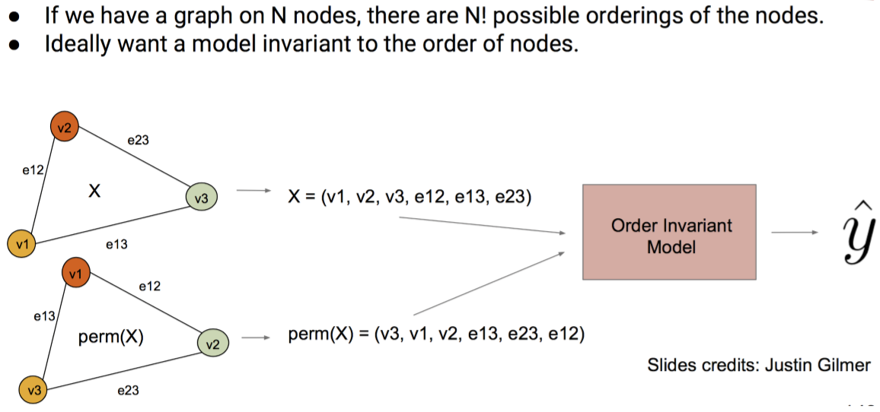
Inductive Bias for Graphs

Slide 43
Today: Deep Learning
Recurrent Neural Networks
Extra:
Neural Architectures with Memory
Learning to Optimize / Learning to Search DNN architecture
Layer-wise pretraining / Auto-Encoder
Learning to Learn
Variants of Input
Tasks in the form of Symbolic input/ outputs / Program Induction
Generative Adversarial Networks (GAN)
Deep Generative Models: Autoregressive Kind
Deep Reinforcement Learning
Robustness / Trustworthiness / Understand / Verify / Test / Evade / Detect Bias / Protect DNN

Slide 44
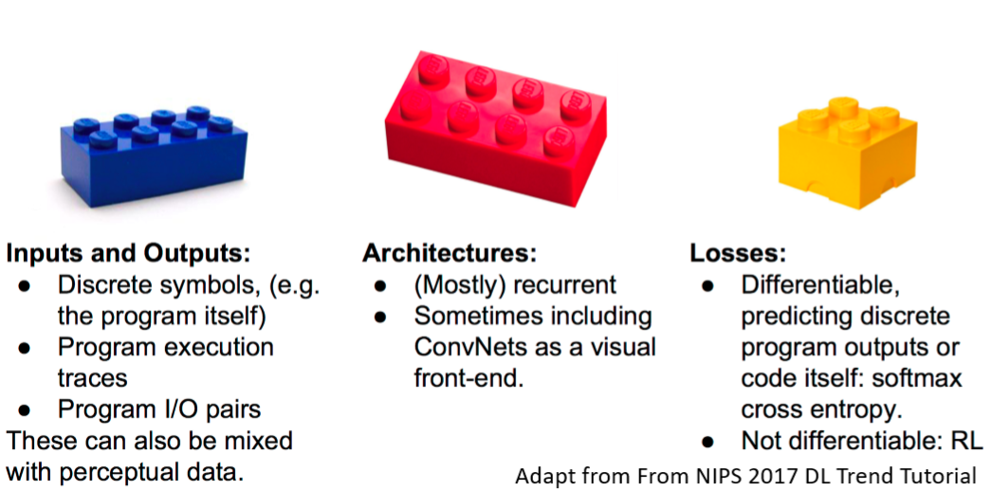
Tasks in the form of Symbolic input/ outputs / Program Induction

Slide 45
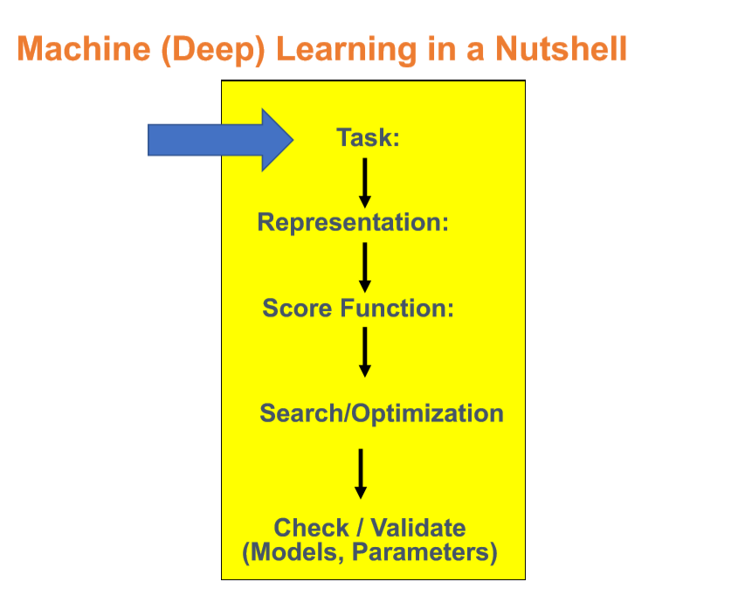

Slide 46
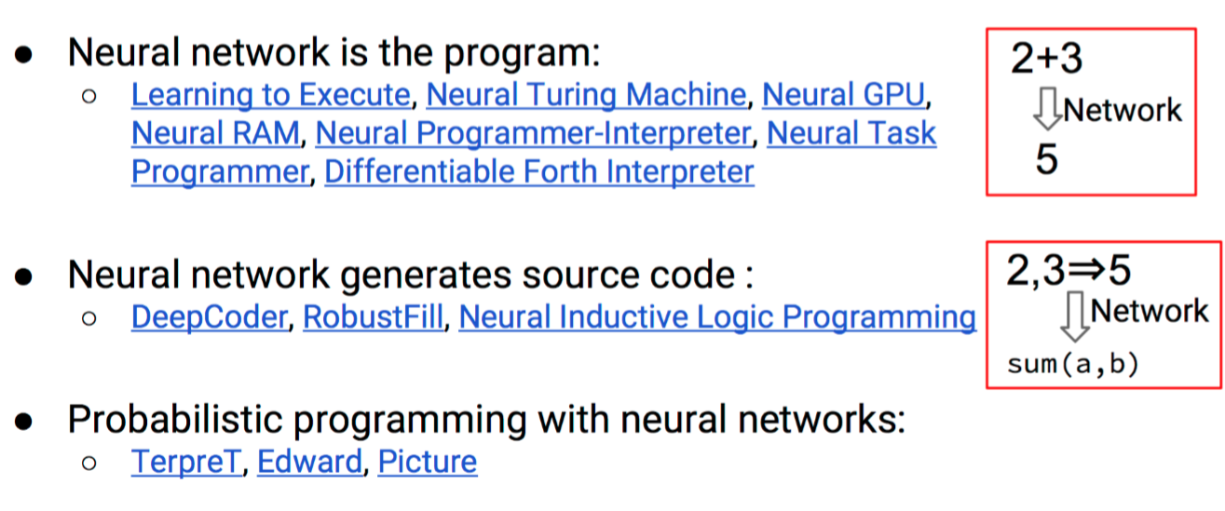
Neural Program Induction-Research Landscape

Slide 47
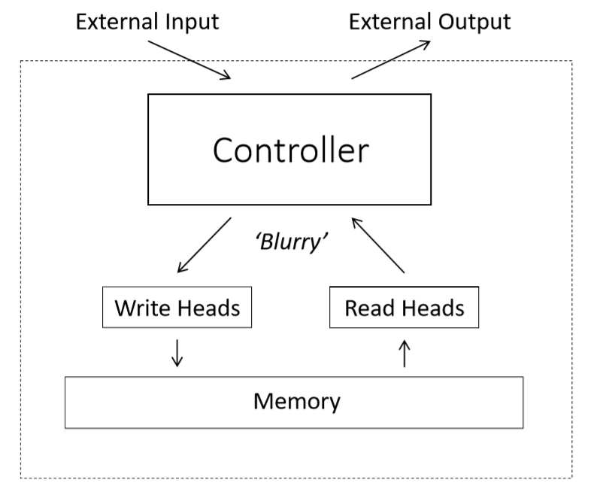
Neural Turing Machines

Slide 48
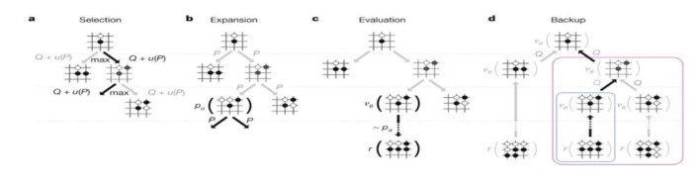
Task with Sequential Symbolic Form
Words, letters, strings, ..
Computer Programs , …
Sequence decision making, e.g., games, RL

Slide 49
Today: Deep Learning
Recurrent Neural Networks
Extra:
Neural Architectures with Memory
Learning to Optimize / Learning to Search DNN architecture
Layer-wise pretraining / Auto-Encoder
Learning to Learn
Variants of Input
Tasks in the form of Symbolic input/ outputs / Program Induction
Generative Adversarial Networks (GAN)
Deep Generative Models: Autoregressive Kind
Deep Reinforcement Learning
Robustness / Trustworthiness / Understand / Verify / Test / Evade / Detect Bias / Protect DNN

Slide 50
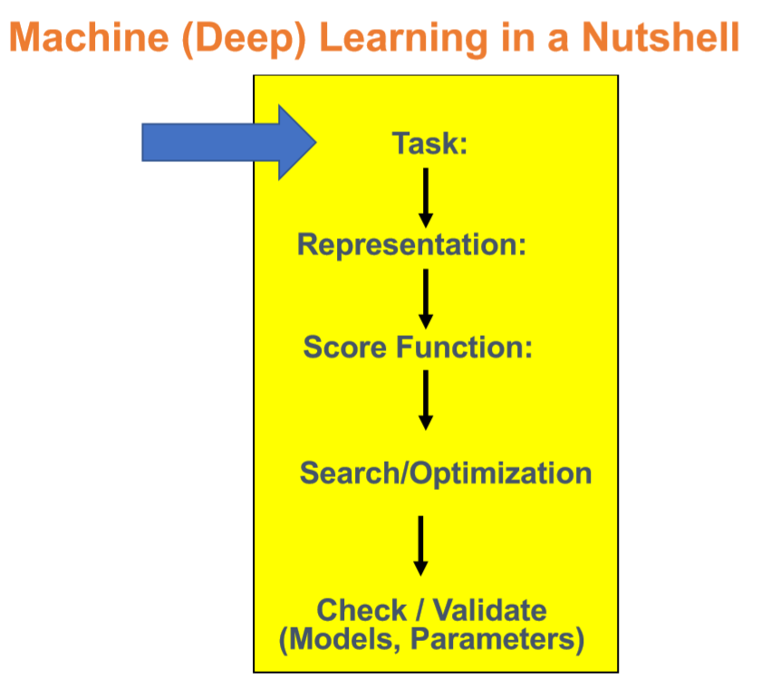

Slide 51
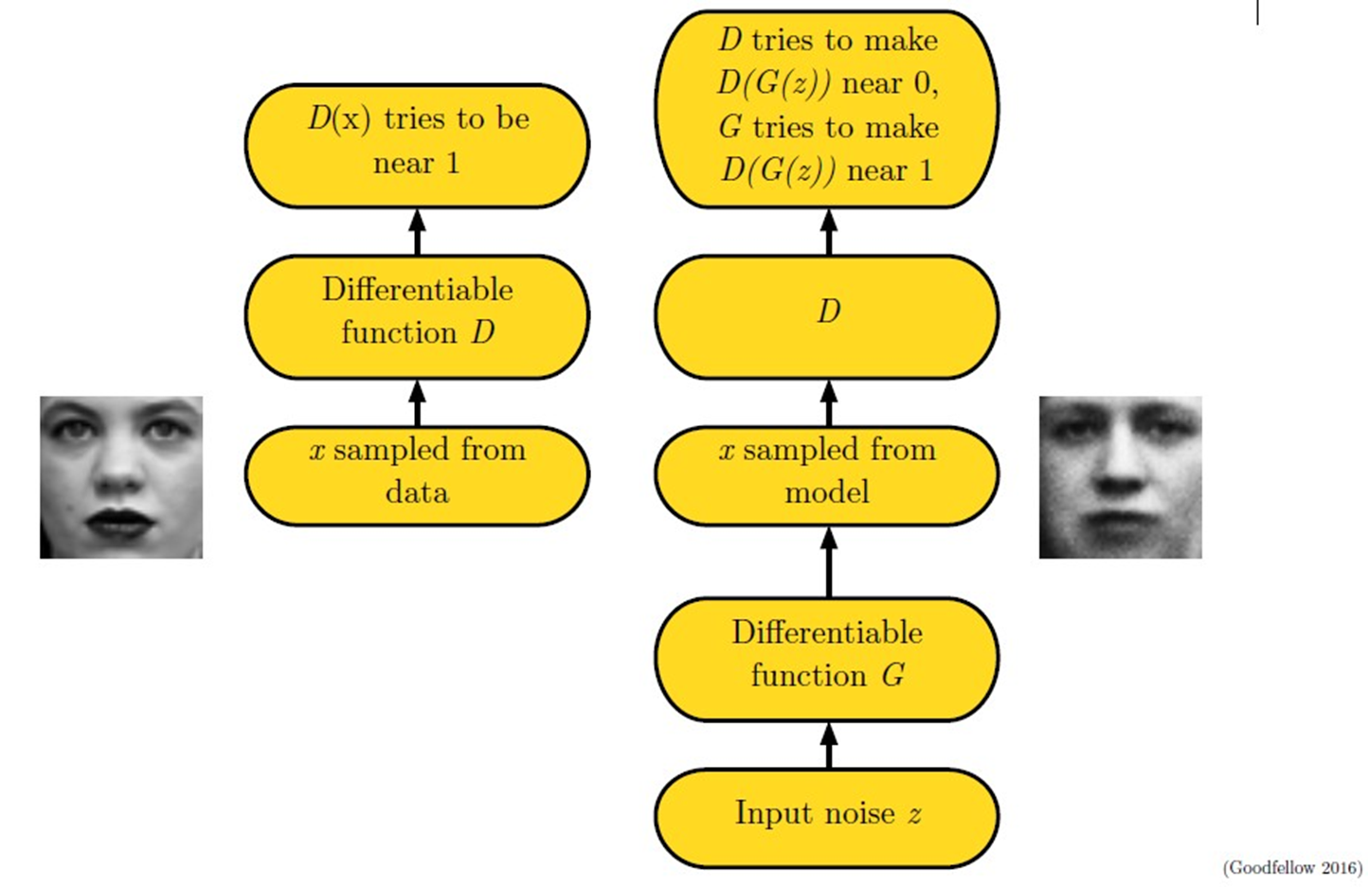
Adversarial Nets Framework

Slide 52
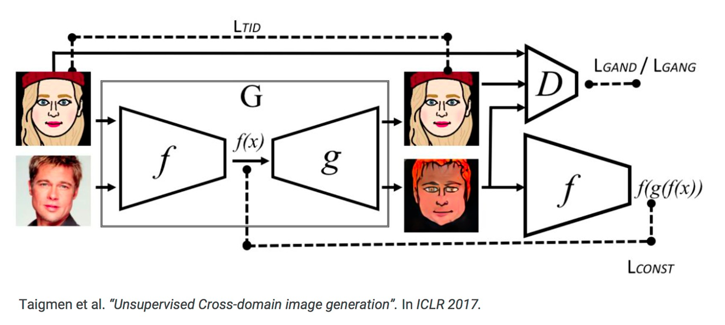
Unsupervised cross-domain image generation

Slide 53
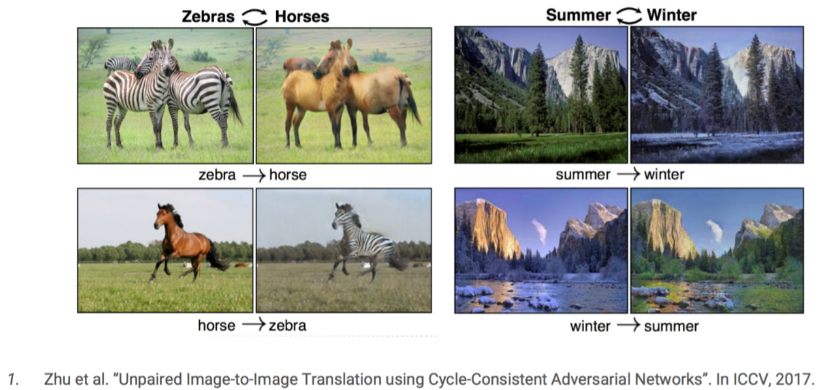
Cycle GAN
Notes:
This paper captures special characteristics of one image collection and figures out how these characteristics could be translated into the other image collection, all in the absence of any paired training examples. CycleGANs method can also be applied in variety of applications such as Collection Style Transfer, Object Transfiguration, season transfer and photo enhancement.

Slide 54
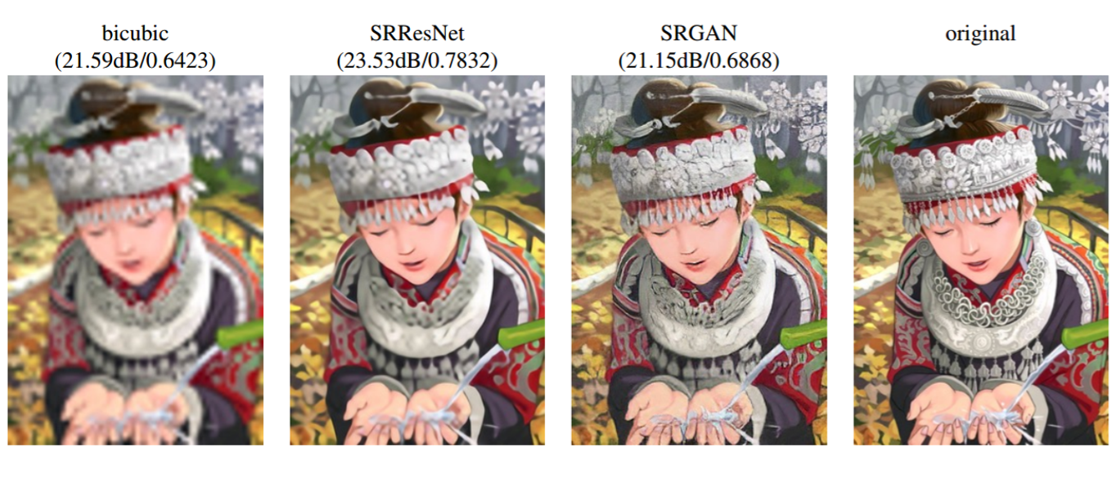
Image Super-Resolution
[Lediget al. CVPR 2017]

Slide 55
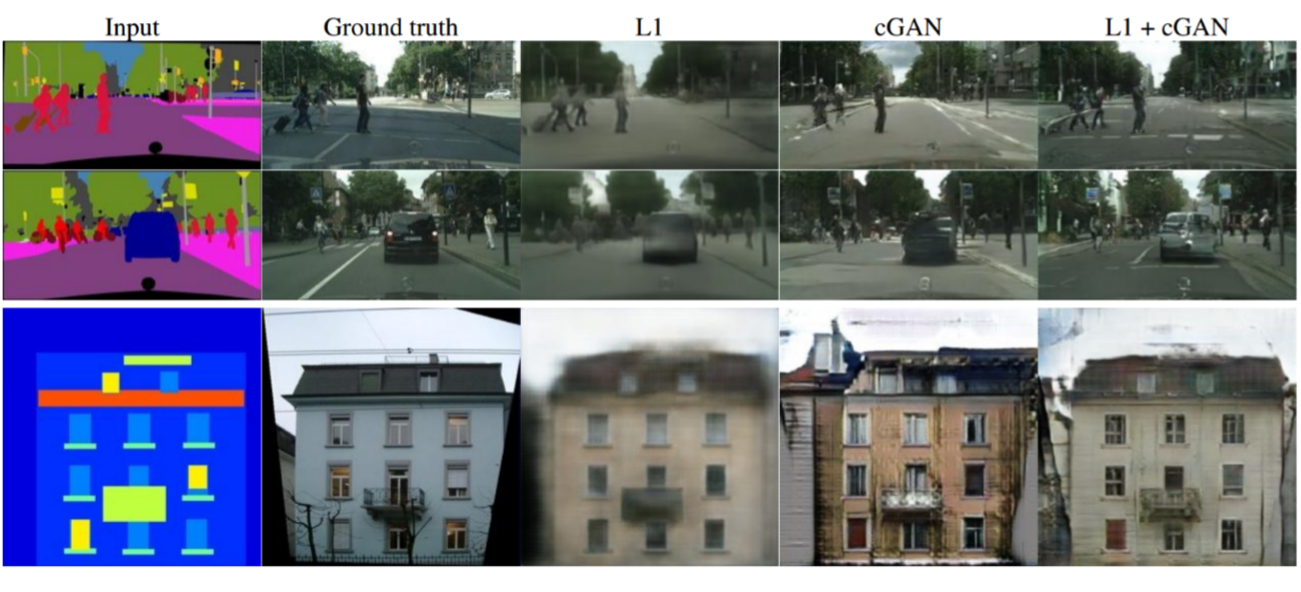
Label2Image
[Isola et al. CVPR 2017]

Slide 56
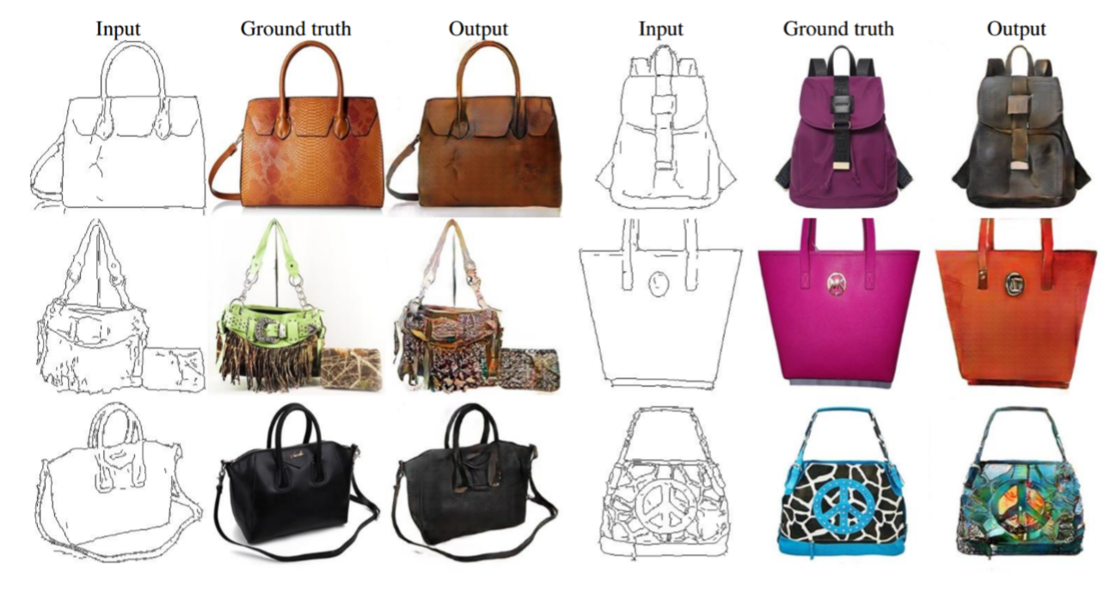
Edges2Image
[Isola et al. CVPR 2017]

Slide 57
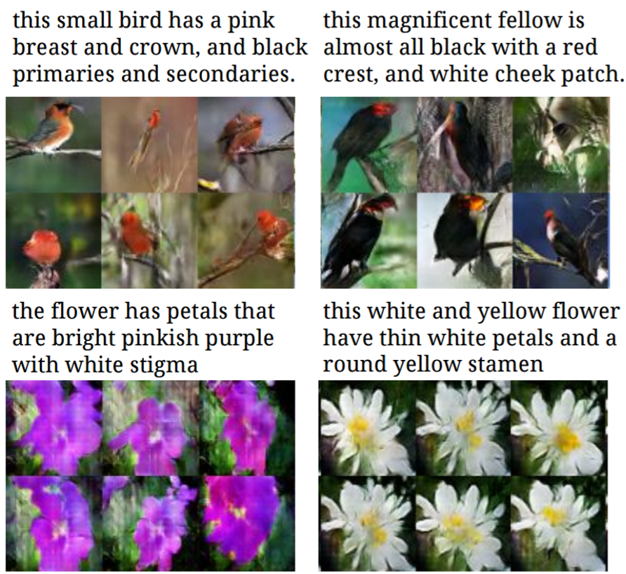
Text2Image
[Reed et al. ICML 2016]

Slide 58
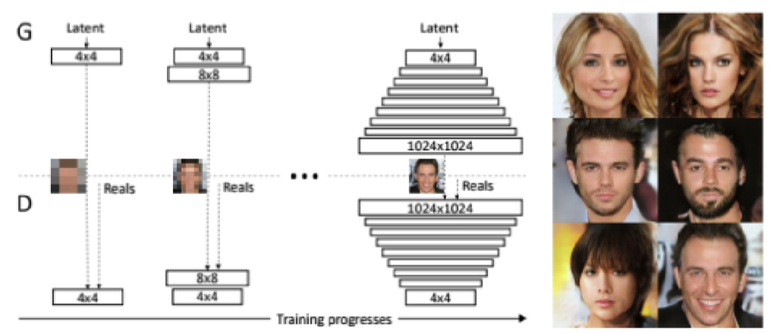
Progressive GAN
PROGRESSIVE GROWING OF GANS FOR IMPROVED QUALITY, STABILITY, AND VARIATION, ICLR 2018

Slide 59
Today: Deep Learning
Recurrent Neural Networks
Extra:
Neural Architectures with Memory
Learning to Optimize / Learning to Search DNN architecture
Layer-wise pretraining / Auto-Encoder
Learning to Learn
Variants of Input
Tasks in the form of Symbolic input/ outputs / Program Induction
Generative Adversarial Networks (GAN)
Deep Generative Models: Autoregressive Kind
Deep Reinforcement Learning
Robustness / Trustworthiness / Understand / Verify / Test / Evade / Detect Bias / Protect DNN

Slide 60
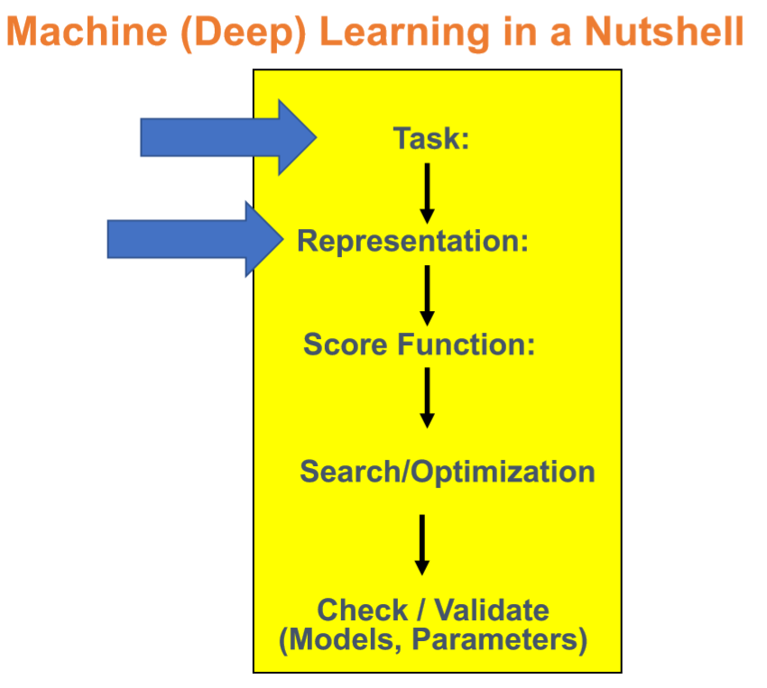

Slide 61
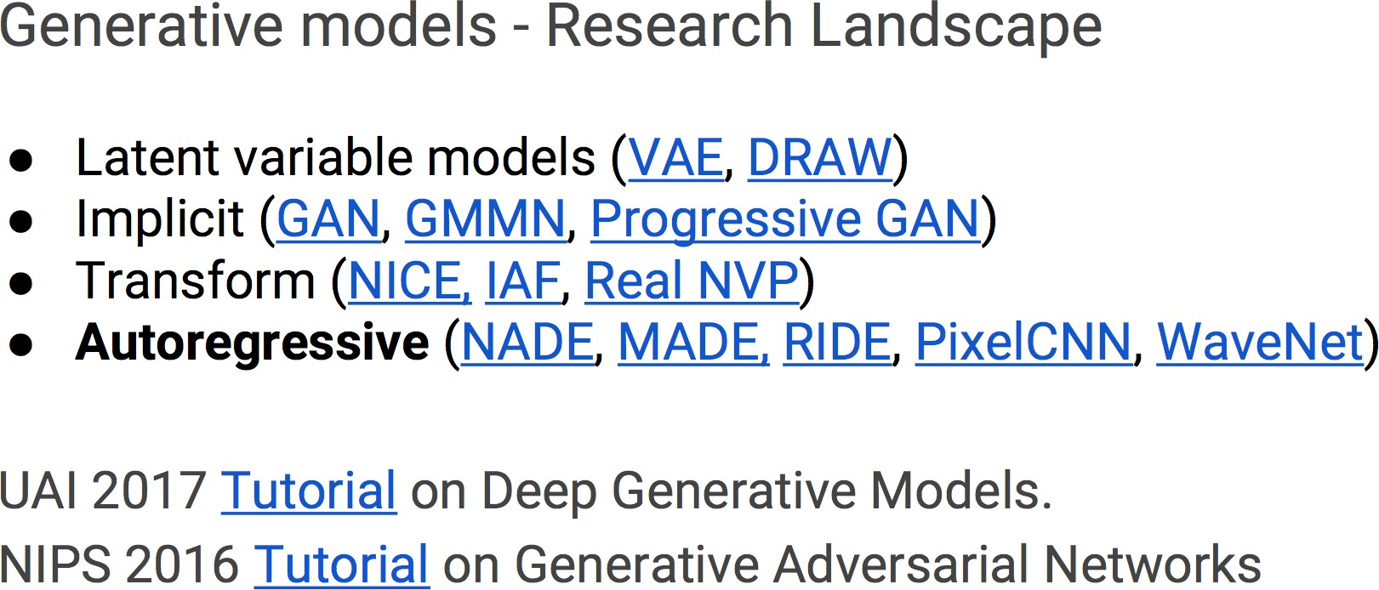
Generative models - Research Landscape

Slide 62
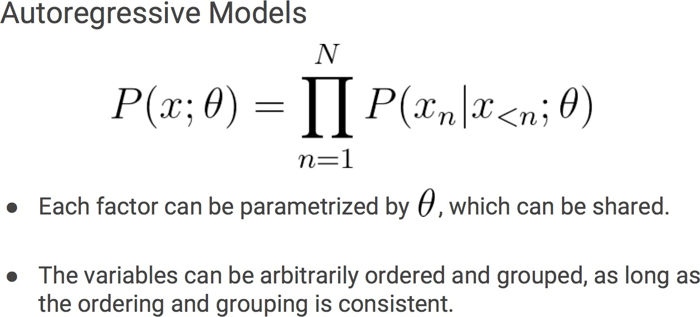
Autoregressive Models

Slide 63
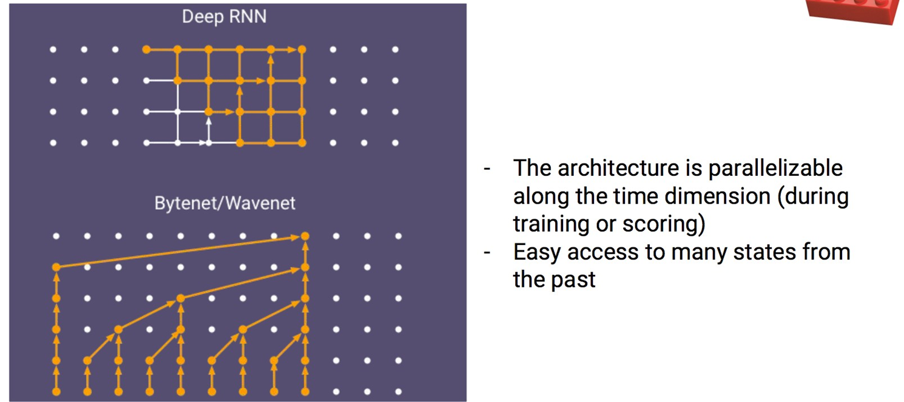
Recurrent versus Causal Convolutional Nets

Slide 64
Why Generative Models?
Excellent test of ability to use high- dimensional, complicated probability distributions
Simulate possible futures for planning or simulated RL
Missing data
Semi-supervised learning
Multi-modal outputs
Realistic generation tasks

Slide 65
Today: Deep Learning
Recurrent Neural Networks
Extra:
Neural Architectures with Memory
Learning to Optimize / Learning to Search DNN architecture
Layer-wise pretraining / Auto-Encoder
Learning to Learn
Variants of Input
Tasks in the form of Symbolic input/ outputs / Program Induction
Generative Adversarial Networks (GAN)
Deep Generative Models: Autoregressive Kind
Deep Reinforcement Learning
Robustness / Trustworthiness / Understand / Verify / Test / Evade / Detect Bias / Protect DNN

Slide 66


Slide 67
Reinforcement Learning (RL)
What’s Reinforcement Learning?
Agent interacts with an environment and learns by maximizing a scalar reward signal
No labels or any other supervision signal.
Previously suffering from hand-craft states or representation.
Environment
{Observation, Reward}
{Actions}
Agent

Slide 68


Deep Reinforcement Learning
Human
What’s DEEP RL?
Environment
{Raw Observation, Reward}
{Actions}

Slide 69

AlphaGO: Learning Pipeline
Combine Supervised Learning (SL) and RL to learn the search direction in Monte Carlo Tree Search
SL policy Network
Prior search probability or potential
Rollout:
combine with MCTS for quick simulation on leaf node
Value Network:
Build the Global feeling on the leaf node situation
Notes:
Silver, David, et al. "Mastering the game of Go with deep neural networks and tree search." Nature 529.7587 (2016): 484-489.

Slide 70


Slide 71


Slide 72
Today: Deep Learning
Recurrent Neural Networks
Extra:
Neural Architectures with Memory
Learning to Optimize / Learning to Search DNN architecture
Layer-wise pretraining / Auto-Encoder
Learning to Learn
Variants of Input
Tasks in the form of Symbolic input/ outputs / Program Induction
Generative Adversarial Networks (GAN)
Deep Generative Models: Autoregressive Kind
Deep Reinforcement Learning
Robustness / Trustworthiness / Understand / Verify / Test / Evade / Detect Bias / Protect DNN

Slide 73


Slide 74

Evade DNN, e.g. Adversarial Examples (AE)
Example from: Ian J. Goodfellow,Jonathon Shlens,Christian Szegedy. Explaining and Harnessing Adversarial Examples. ICLR 2015.

Slide 75

Evade DNN, e.g. Adversarial Examples (AE)

Slide 76

BreakingCNNs
Intriguing properties of neural networks [Szegedy ICLR 2014]

Slide 77

BreakingCNNs
Deep Neural Networks are Easily Fooled: High Confidence Predictionsfor Unrecognizable Images [Nguyen et al. CVPR2015]

Slide 78


Cat-and-nouse game

Slide 79

Bias in DNN
e.g. Men Also Like Shopping: Reducing Gender Bias Amplification using Corpus-level Constraints, EMNLP 2017

Slide 80

Verify DNN
e.g. “Reluplex: An efficient SMT solver for verifying deep neural networks.” International Conference on Computer Aided Verification. 2017.

Slide 81
Recap: Some Recent Trends
1. CNN / Residual / Dynamic parameter
2. RNN / Attention / Seq2Seq / BERT …
3. Neural Architecture with explicit Memory
4. Learning to optimize / Learning DNN architectures
5. Autoencoder / layer-wise training
6. Learning to learn / meta-learning/ few-shots
7. DNN on graphs / trees / sets
8. NTM 4program induction / sequential decisions
9. Generative Adversarial Networks (GAN)
10. Deep Generative models, e.g., autoregressive
11. Deep reinforcement learning
12. Validate / Evade / Test / Understand / Verify DNNs
New Network topology
New Losses
New Inputs
New Tasks
New Model Properties

Slide 82
References
https://qiyanjun.github.io/2019f-UVA-CS6316-MachineLearning/
Dr. Yann Lecun’s deep learning tutorials
Dr. Li Deng’s ICML 2014 Deep Learning Tutorial
Dr. Kai Yu’s deep learning tutorial
Dr. Rob Fergus’ deep learning tutorial
Prof. Nando de Freitas’ slides
Olivier Grisel’s talk at Paris Data Geeks / Open World Forum
Hastie, Trevor, et al. The elements of statistical learning. Vol. 2. No.1.New York: Springer, 2009.
Dr. Hung-yi Lee’s CNN slides
NIPS 2017 DL Trend Tutorial

Slide 83
Thanks for listening

